Slide 1
Foundations of Modern Software Systems
Module-2, Lecture-4
Instructor: Piyush Goel
N.M.A.M. Institute of Technology

Slide 2
Recap - Lecture - 2/3

Slide 3
Storage: Data Types
Numbers
Integers
Signed
Unsigned
Decimals
Low Precision
High Precision
Characters
Enums
Boolean
Function
Array
Pointer
Reference
Class
Structure
Union
Dictionary
Strings
Tuples
List
Set
Complex Number
Byte
Int
Array
Short
String
Set
List
Question: How would I store a Boolean? How many bytes do I need to store a boolean value?

Slide 4
Questions - 1: Decimals
What is single-precision and double-precision for decimals?
What could be an impact of incorrect precision or round-off?
Watched the movie “Office Space?
Rockets can explode? :))
IEEE-754 - Do Read this.
What type of use-cases need high precision Decimals?

Slide 5
Questions - 2: Strings
How many bytes do I need to store Strings?
How do I store non-Latin or non-English characters?
Character Sets
Unicode
Encodings
Variable Length Character Encodings (UTF-8)
Lang and Locale
Practical Example - Zomato
Ever heard of Mojibake?
How do I sort similar looking characters? (A vs Ä)
Collation

Slide 6
Questions - 3: Time
How do I represent Time?
MySQL has 4 different data-types
Date
Time
DateTime
Timestamp
Year
What about Timezones?

Slide 7
Questions - 4: Binary Objects
How do I store random binary objects?
Music files
Images
PDF files
Homework: Try to store a PDF file or a JPEG Image in a MySQL database.

Slide 8
Data Types: Storage Systems
MySQL - https://dev.mysql.com/doc/refman/8.0/en/data-types.html
MongoDB - https://www.mongodb.com/docs/mongodb-shell/reference/data-types/
SQLite - https://www.sqlite.org/datatype3.html

Slide 9
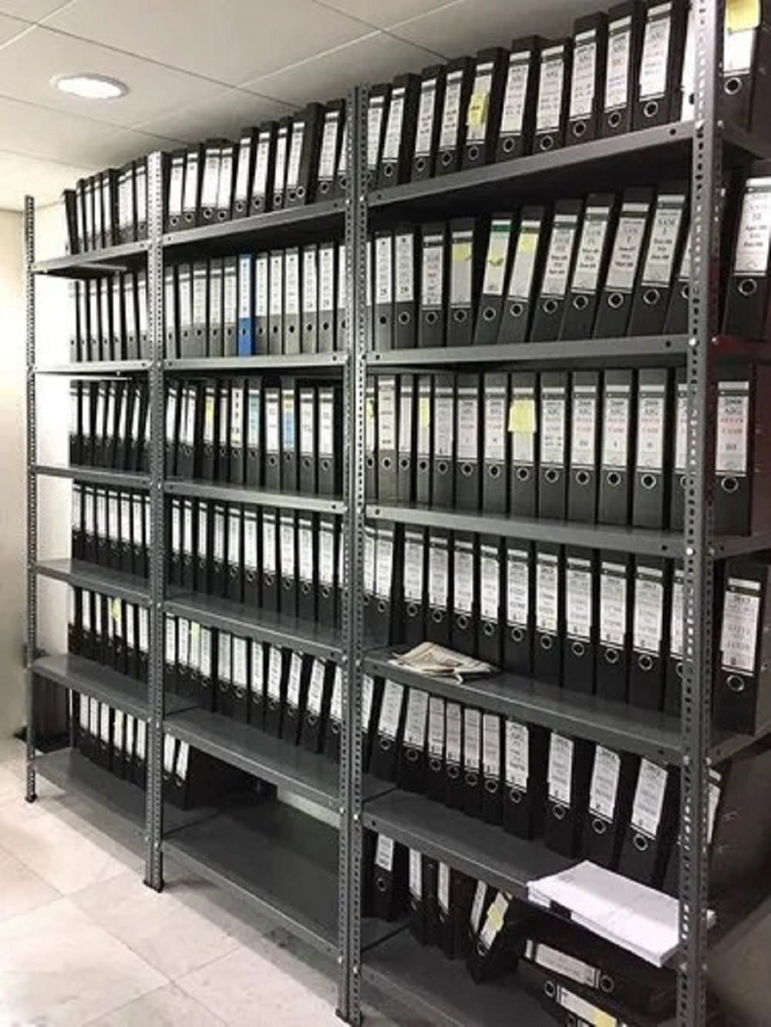
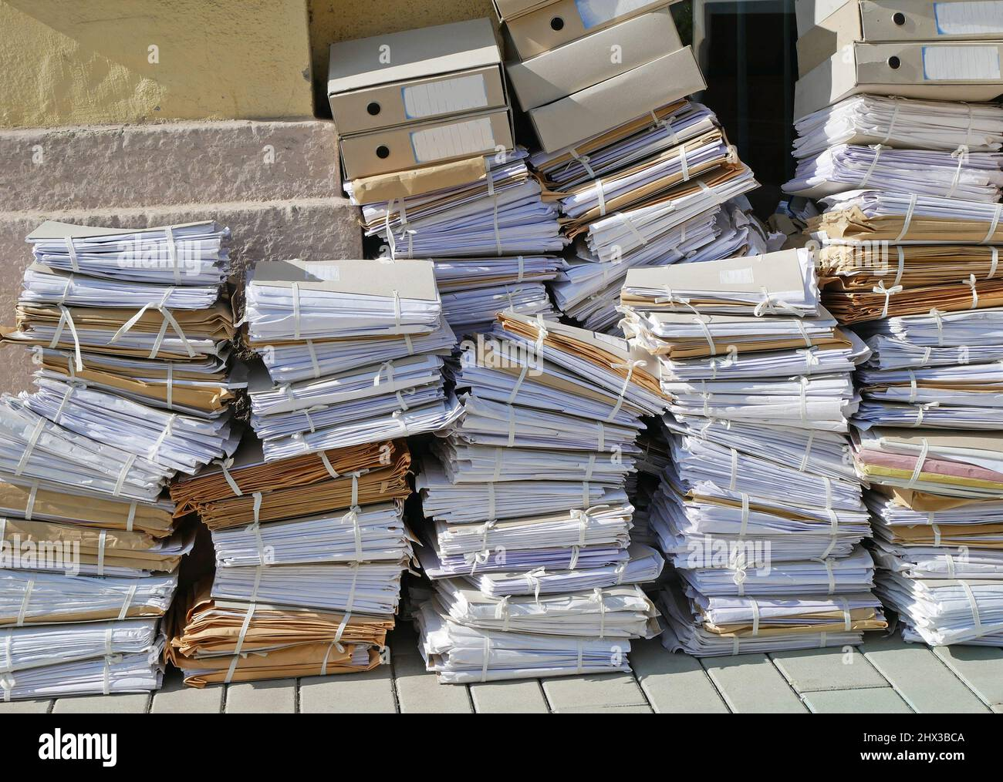
Storage - Fundamentals - File Systems
Why do we need File Systems?

Slide 10
Storage - Fundamentals - File Systems
Distributed File Systems:
Google - Google File System (GFS)
Yahoo - Hadoop Distributed File System (HDFS)
https://www.youtube.com/watch?v=vdkx2xasGlM&ab_channel=Udacity
https://www.youtube.com/watch?v=4Gfl0WuONMY&ab_channel=InfoQ

Slide 11
Storage - Fundamentals
File Systems
Serialisation
Compression
Ad-hoc things.

Slide 12
Storage: Fundamentals - Serialisation
What is Serialisation? Why is it needed?

Slide 13
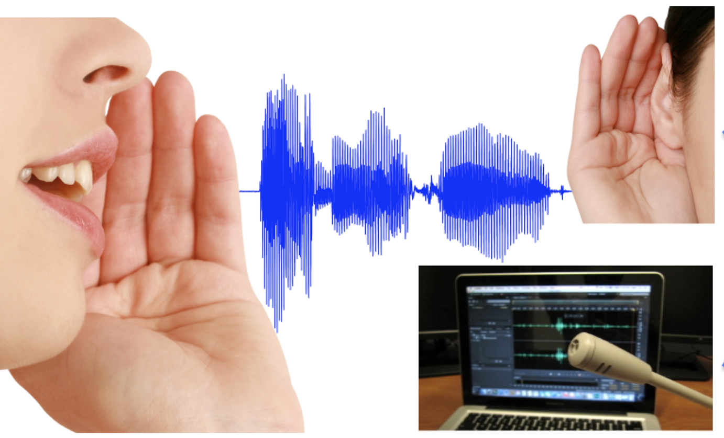
Storage: Fundamentals - Serialisation
How do we comprehend speech? How do you understand when someone is speaking?

Slide 14
Storage - Fundamentals - Serialisation
In computing, serialization (or serialisation) is the process of translating a data structure or object state into a format that can be stored (e.g. files in secondary storage devices, data buffers in primary storage devices) or transmitted (e.g. data streams over computer networks) and reconstructed later (possibly in a different computer environment). When the resulting series of bits is reread according to the serialization format, it can be used to create a semantically identical clone of the original object.
https://en.wikipedia.org/wiki/Serialization

Slide 15
Storage - Fundamentals - Serialisation
Different Methods of Serialisation
Human Readable
CSV
JSON - Popular in Internet Systems
XML
YAML
Machine Readable
Binary Formats
Thrift (Made by Facebook), ProtoBuf (Made by Google), MsgPack
Binary JSON (BSON used by MongoDB)
Proprietary or Application Specific Formats

Slide 16
Storage - Fundamentals - Serialisation
Different Methods of Serialisation
Language Specific
Java Serialisation (Serializable keyword)
Python Pickle
Ruby Marshal
Language Agnostic
CSV
JSON
XML

Slide 17
Storage - Fundamentals - Serialisation
Different Methods of Serialisation
Verbose
JSON
XML
Compact
MsgPack
ThriftCompact
Other Binary Protocols

Slide 18
Storage - Fundamentals - Compression

Slide 19
Storage - Fundamentals - Compression
In information theory, data compression, source coding, or bit-rate reduction is the process of encoding information using fewer bits than the original representation. Any particular compression is either lossy or lossless. Lossless compression reduces bits by identifying and eliminating statistical redundancy. No information is lost in lossless compression. Lossy compression reduces bits by removing unnecessary or less important information. Typically, a device that performs data compression is referred to as an encoder, and one that performs the reversal of the process (decompression) as a decoder.
https://en.wikipedia.org/wiki/Data_compression

Slide 20
Storage - Fundamentals - Compression
Huffman Coding Algorithm?

Slide 21
Lecture - 4

Slide 22
Storage - Fundamentals
Structuring (Modeling) & Querying
Databases
Types
Use-Cases
Object Storage

Slide 23
Storage - Fundamentals - Modeling
Sample Dataset
Names = (Cristiano Ronaldo", "Lionel Messi", "Haalaand", "Mohamed Salah", "Thomas Muller")
Club = ("Manchester United", "PSG", "Manchester City", "Liverpool", "Bayern Munich")
Country = (Portugal, Argentina, Norway , Egypt, Germany)

Slide 24
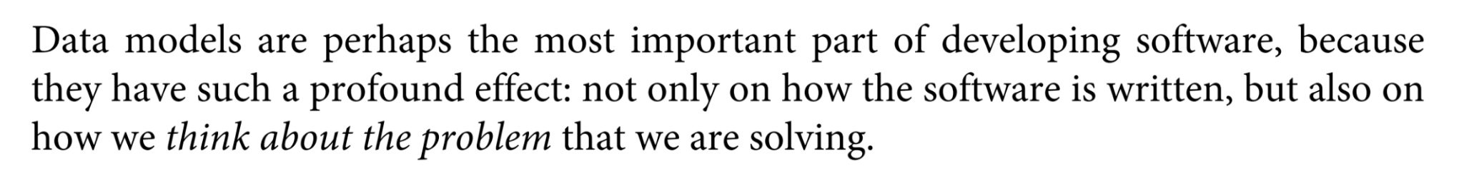
Storage - Fundamentals - Modeling
- Martin Kleppmann, Designing Data Intensive Applications
- @martinkl
A strong handle on data modeling will help you in your career!
Object Oriented Design
API Design
Data Structures

Slide 25
Storage - Fundamentals - Modeling
Let’s work on some examples.

Slide 26
Storage - Fundamentals - Modeling
What is a Relation in Set Theory?

Slide 27
Storage - Fundamentals - Modeling
How do we model current data set as Relations?

Slide 28
Storage - Fundamentals - Modeling
Record Identification?

Slide 29
Storage - Fundamentals - Modeling
Record Identification? Keys?
Candidate Keys
Primary Keys
Read up on UUIDs - https://en.wikipedia.org/wiki/Universally_unique_identifier

Slide 30
Storage - Fundamentals - Modeling
Possible Checks on the Values?

Slide 31
Storage - Fundamentals - Modeling
Object Structure
Data Types
Relation Keys
Constraints (Checks)

Slide 32
Storage - Fundamentals - Modeling
What we have just discussed is Schema?

Slide 33
Storage - Fundamentals - Modeling
How do we define Set Operations on the data set?

Slide 34
Storage - Fundamentals - Modeling
Intersection, Union, Set Difference?

Slide 35
Storage - Fundamentals - Modeling
Join Operations

Slide 36
Storage - Fundamentals - Modeling
Inner Join

Slide 37
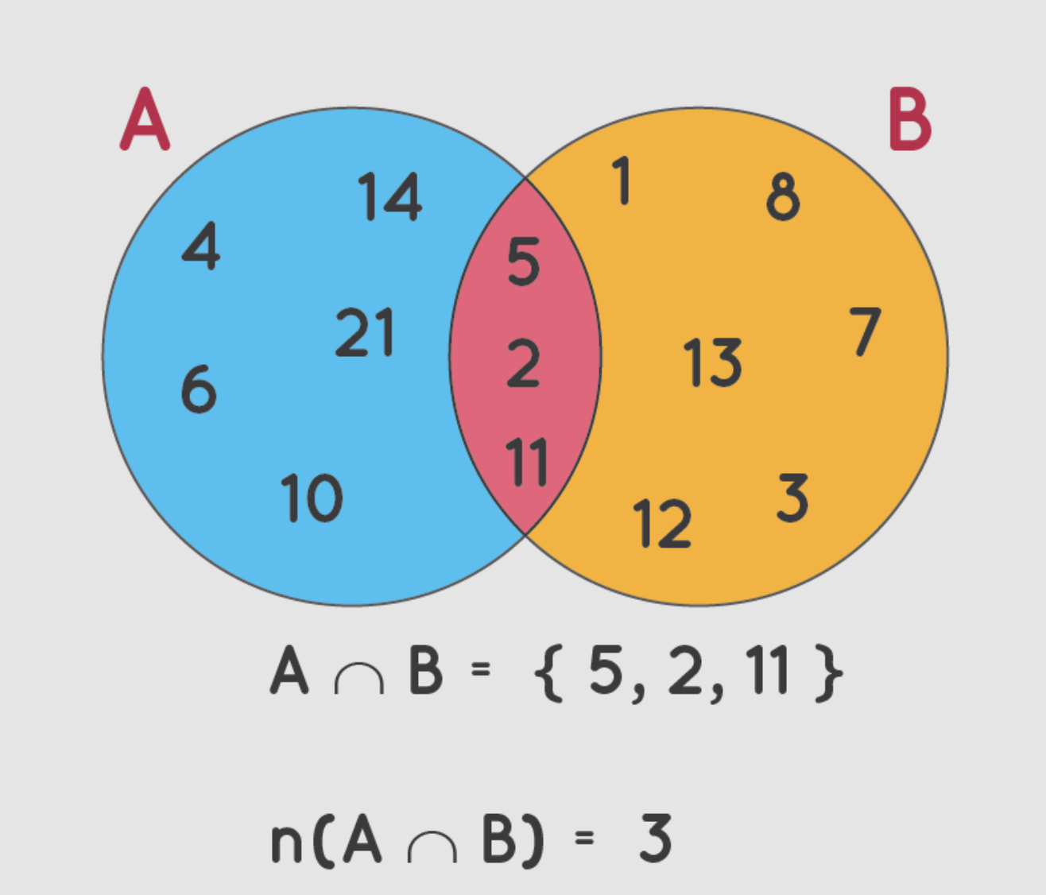
Storage - Fundamentals - Modeling

Slide 38
Storage - Fundamentals - Modeling
Outer Join

Slide 39
Storage - Fundamentals - Modeling

Slide 40
Storage - Fundamentals - Modeling
Left Outer Join

Slide 41
Storage - Fundamentals - Modeling
Right Outer Join

Slide 42
Storage - Fundamentals - Modeling
Full Outer Join

Slide 43
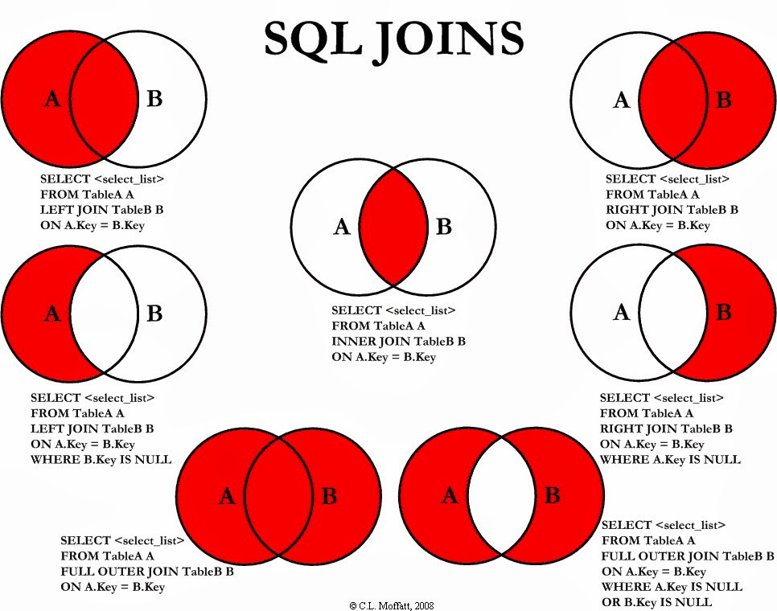
Storage - Fundamentals - Modeling

Slide 44
Storage - Fundamentals - Modeling
Join Algorithms? *
Homework
* Will strengthen your knowledge of data-structures!

Slide 45
Storage - Fundamentals - Modeling
Data Modeling Paradigms
Relational
Non-Relational
Document Oriented
Key-Value
Columnar
Graph
Time-Series

Slide 46
Storage - Fundamentals - Modeling - Relational
Relational
Model Data as a collection of “entities” and their “relationships”
Entities identified through Keys
Relationships:
One to One
One to Many
Many to Many
Tables for Entities, and Relationships.
Objects represented using “Joined” entities.

Slide 47
Storage - Fundamentals - Modeling - Relational
Non-Relational
Model Data as Self-Contained Objects
Identified by Keys or Identifiers
What kind of Data Structures do they model?
No concept of Joining as objects are self-contained

Slide 48
Storage - Fundamentals - Modeling
What are the pros, and cons of Relational and Non-Relational Modeling?

Slide 49
Storage - Fundamentals - Modeling
What are the pros, and cons of Relational and Non-Relational Modeling?
Homework

Slide 50
Storage - Fundamentals
Querying

Slide 51
Storage - Fundamentals - Querying
Declarative
Imperative

Slide 52
Storage - Fundamentals - Querying
Declarative
Structured Query Languages (SQL)
XQuery (XPath)
SPARQL
Cypher
Imperative
Not really popular in data storage ecosystems.

Slide 53
Storage - Fundamentals
Structuring (Modeling) & Querying
Databases
Types
Use-Cases
Object Storage

Slide 54
Questions

